Slide 1
Risk Indicators in Risk Parity Portfolio
QF634 G1-10
Lim Tze Hao Wong Yong Wen
Lim Wei Qi Dickson Tan
Lee Qianxin Peter Chettiar
Kim Sang Hwee

Slide 2
01
Abstract
02
Literature Review
contents
03
Suggested Methodology
04
PRELIMINARY Results

Slide 3
Abstract
Risk has always been existent in the financial markets and both academics and practitioners have sought after ways to minimize it. Risk Parity Portfolio in particular, an investment management strategy which focuses on allocation of risk rather than allocation of capital, has drawn attention in the recent years due to its robustness during financial crises. But are these portfolios truly protected well enough from all kinds of crises? In this research, we analyse methods to formulate risk indicators that predict and alert investors prior to market downside. Firstly, we create a Risk Parity Portfolio. Secondly, we formulate a unique risk indicator, a combination of multiple risk indicators, to determine the “Risk On” and “Risk Off” period. Lastly, we prove our methodology with past data from Bloomberg through back testing of In/Out-of-sample testing.

Slide 4
Introduction to risk parity
Markowitz mean-variance asset allocation is not so simple to implement since it is difficult to forecast returns or the drift of the portfolio.
A risk parity portfolio is an asset allocation method that does not require forecasts of expected returns unlike the mean-variance portfolio (Fabozzi et al, 2021)
Risk parity portfolio has equal risk or volatility contribution by each asset making up the portfolio (Qian, E., 2011) [1],

Slide 5
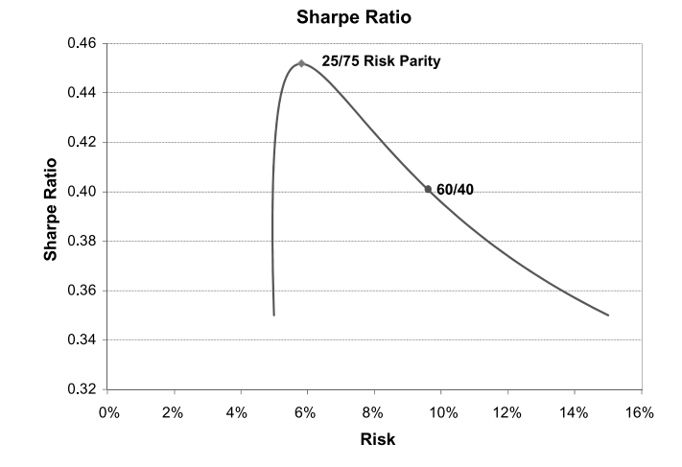
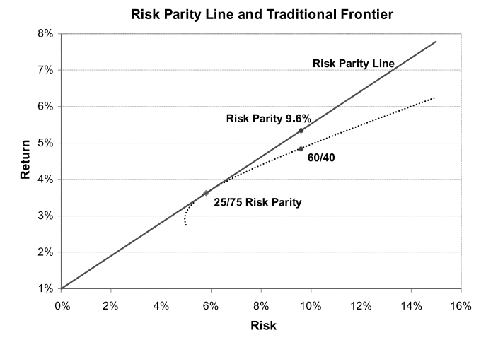
Sharpe ratio and returns of Risk parity portfolio

Slide 6
Definition of financial stress
Financial markets can be deemed to be experiencing financial stress when their usual behavior is disrupted (Hakkio & Keeton, 2009)
Furthermore, while some periods of financial stress do not really affect the economy, financial stress in banking, securities and foreign exchange markets can occasionally be associated with severe economic downturns. (Cardarelli et al, 2011)

Slide 7
Financial Stress Features
Based on the definition of financial stress, financial stress can be said to have the following features (Hakkio & Keeton, 2009):
Greater volatility in stock prices due to increased uncertainty about fundamental values of financial assets and increased uncertainty about behavior of other investors.
Increased cost of borrowing since investors demand a higher rate of return due to increased asymmetry of information
Flight to quality and flight to liquidity due to unwillingness to hold risky assets and illiquid assets

Slide 8
Literature Review – Risk On/Risk Off
Ever since the global financial crisis in 2008, the terms “Risk On” and “Risk Off” have been continuously used in the financial markets to describe situations whereby investors are either adding on risk or deleveraging their existing risk (Lee, 2012).
What does risk-on and risk-off truly mean? How does it affect the markets and investors? Risk-on refers to times when the global markets have more appetite to take on additional risk, and naturally investors load on more risk assets to their portfolio. It goes the same way for risk-off where the global markets fear a downside and a sell-off occurs to deleverage the risk in the portfolio.
It has become popular in the recent years to strategize one’s portfolio using Risk Parity, where all assets contribute equal risk/volatility to the portfolio. In our research, we aim to make use of several financial risk indicators to navigate through the financial markets to maximize returns of these Risk Parity Portfolios.
By determining risk-on/off situations using these risk indicators, we can control the portfolio such that before any occurrence of risk-off markets, the portfolio is able to reduce its exposure to risky assets such as stocks and diversify itself into riskless or low risk assets such as Bonds and Gold. This will allow us to preserve our returns prior to any market drawdown and when the market signals for a risk-on, the portfolio will adjust once again to load on riskier assets so as to maximize returns.

Slide 9
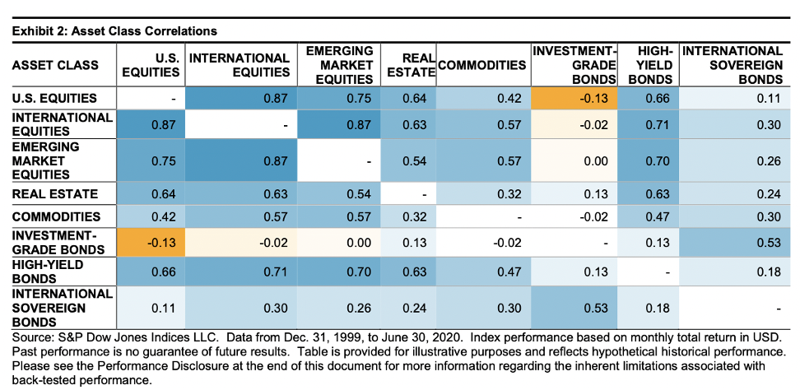
Literature Review – Risk Parity PoRTFOLIO CONSTRUCTION (1)
Strong positive correlations between the equity regions and moderately positive correlations to real estate, commodities, and high-yield bonds.
Equities were negatively correlated with investment-grade bonds.
Adding investment-grade bonds, could lower portfolio volatility and potentially deliver higher returns per unit of risk.

Slide 10
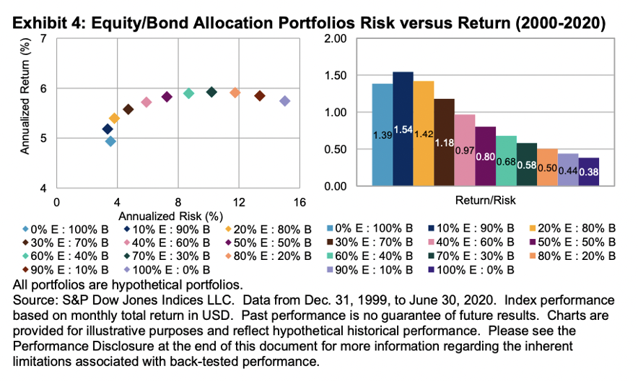
Literature Review – Risk Parity PoRTFOLIO CONSTRUCTION (2)
Combining the two assets led to several allocation mixes could possibly lead to higher risk-adjusted ratios.
The 10/90 equity/bond portfolio had lower volatility relative to bonds along with higher returns
Potential diversification benefit of combining low- correlated assets in a portfolio.

Slide 11
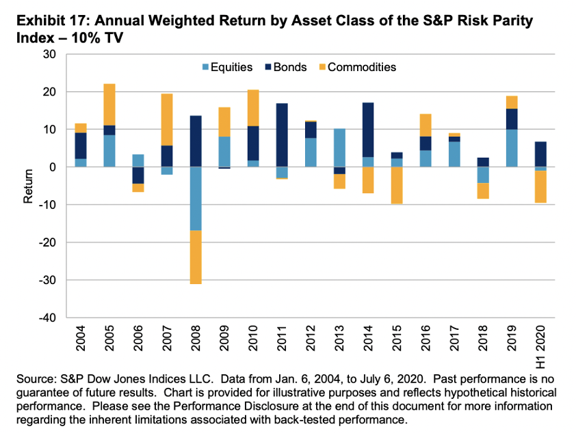
Literature Review – Risk Parity PoRTFOLIO CONSTRUCTION (3)
Equal risk allocation did not lead to equal return contribution: Fixed income contributed the highest return to the overall portfolio over the period
In 2008 and early 2020, equities and commodities experienced market drawdown, and only fixed income had a positive return. As a result, the overall portfolio posted a loss.

Slide 12
Literature Review – Risk Parity PoRTFOLIO CONSTRUCTION (4)
Another key feature of risk parity strategies is leverage.
Risk parity portfolios tend to have a higher allocation to asset classes with lower volatility, such as fixed income.
Equal risk contribution and leverage allows the risk parity portfolio to achieve market returns while reducing the risk of a multi- asset portfolio.
Risk parity strategies aim to build balanced risk exposure portfolios that deliver higher risk-adjusted returns than the broad-based market or a traditional 60/40 portfolio.

Slide 13
Methods of Risk index construction

Slide 14
Kansas city financial stress index risk indicator requirements
The KCFSI has several requirements for variables that can be referred to when constructing a risk index. Variables must: (Hakkio & Keeton, 2009)
Represent one of more of the 5 features of financial stress,
Be indicators of prices or yields which react most quickly
Be available at least monthly
Go back to 1990 in order to be able to determine past periods of financial stress.

Slide 15
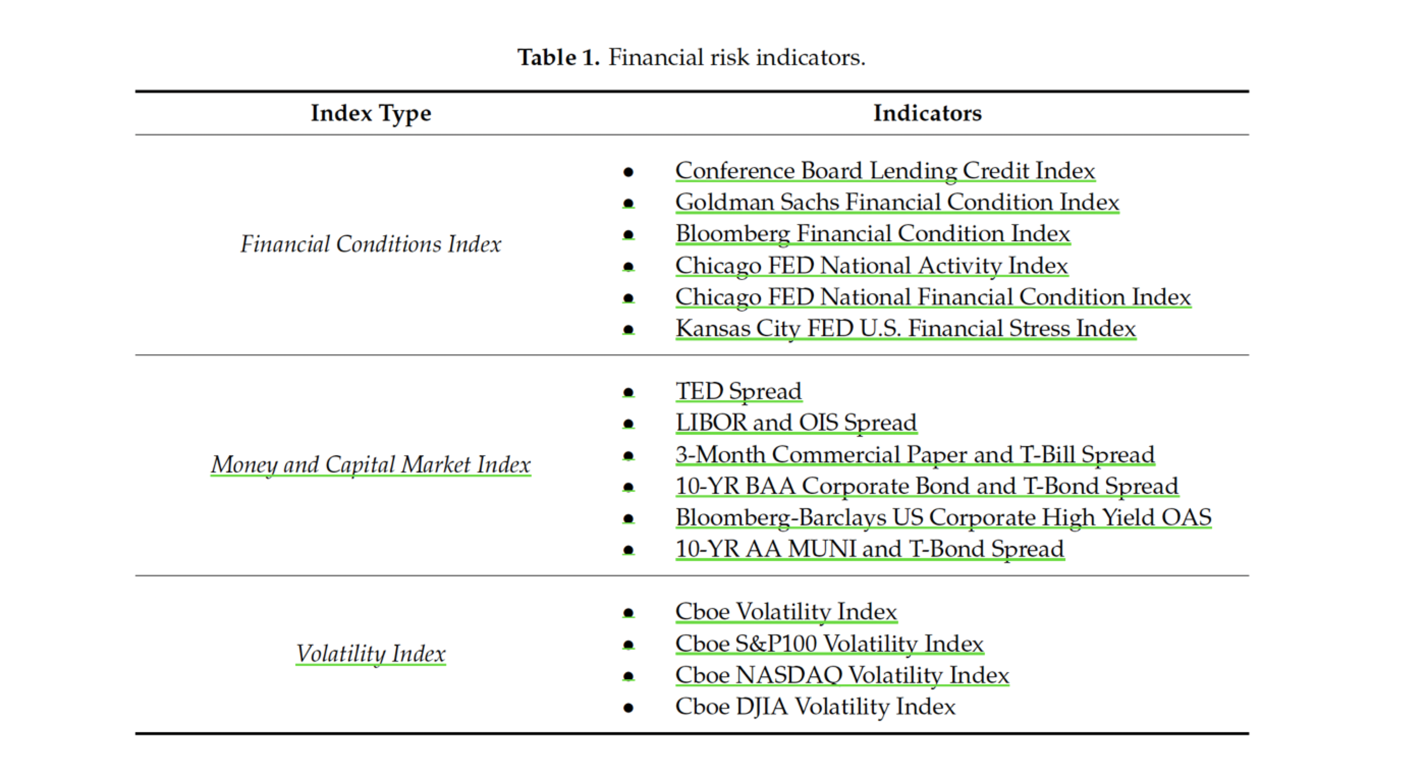
Lit Review – SVM using Risk Indicators
3 types of indicators: financial conditions indicators, money and capital market indicators, and market volatility indicators.

Slide 16
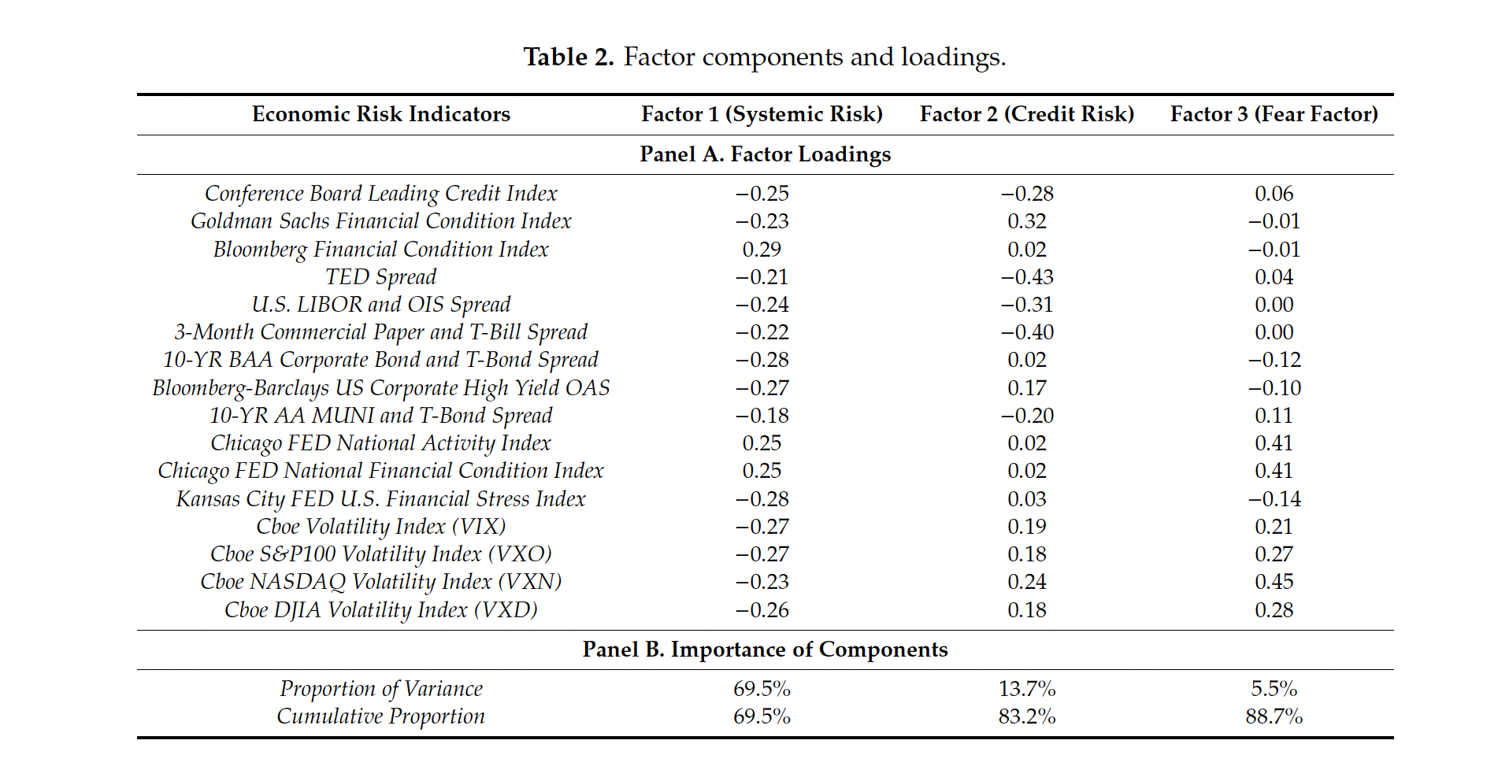
Lit Review – SVM using Risk Indicators
Use PCA to split into 3 Factors of Systemic Risk, Credit Risk and Fear Factor
3 risk factors cumulatively explain about 90% of total variation

Slide 17
Lit Review – SVM using Risk Indicators
Monthly data used over the period from December 2001 to December 2019
ETF funds in the U.S. market:
SPRD S&P 500 ETF trust (SPY),
iShares Core S&P 500 ETF (IVV)
Vanguard Total Stock Market ETF (VTI)
Invesco QQQ Trust

Slide 18
Lit Review – SVM using Risk Indicators
Classify price momentum patterns with signal of 3% so as not to capture too many breakout price patterns.
Notably, all three principal factors and the breakout signals move closely together.
Use SVM to buy the ETF asset as when it detects a reversal in momentum

Slide 19
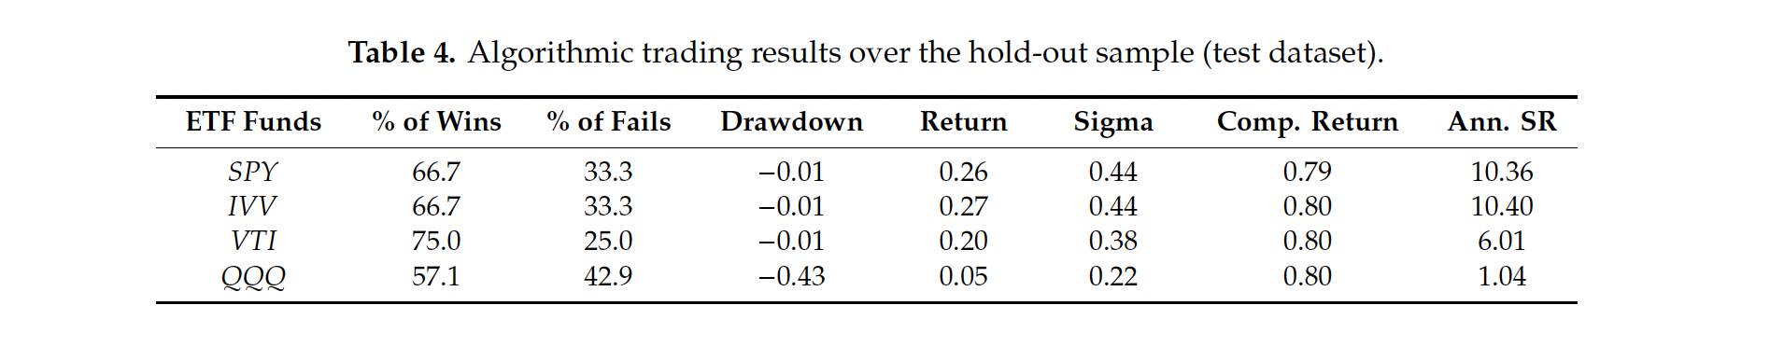
Lit Review – SVM using Risk Indicators
The percentage of total winning months is greater than 57%.
Except for QQQ, the average monthly return for SPY, IVV, and VTI are greater than 20%.
The drawdown of QQQ is relatively higher than that of other ETF assets.
The average of the annual Sharpe ratios is about 7.0
SVM trading performances are robust to the sample periods.

Slide 20
Lit Review – Using risk appetite from regression
Idea of investor risk appetite
In periods of low-risk appetite, riskier assets have low return while safe assets (USD or developed countries' bond) outperforms
In periods of high-risk appetite, the opposite is observed
Regression of assets' returns on risk
Negative correlation when risk off (low risk appetite)
Positive correlation when risk on (high risk appetite)
Global Risk Appetite Index (GRAI) by Kumar and Persuad (2002)
Daily Regression of risk and returns of 17 currencies
Risk Appetite Index by Wilmot, Mielczarski and Sweeney (2004)
Daily Regression of risk and returns of 64 indices of bonds and equities

Slide 21
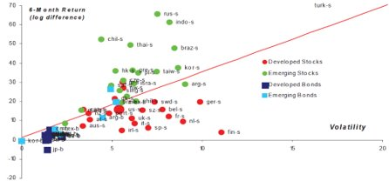
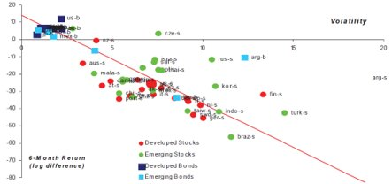
Lit Review – Using risk appetite from regression
Example from Risk Appetite Index by Wilmot, Mielczarski and Sweeney (2004)
Risk On (March 2000) peak of Internet Bubble​ | Risk Off (October 2002) bearish mood​
​ | ​

Slide 22
Literature Review – Sentiment index (1)
Early Warning Indicators (EWIs) have mostly relied on conventional economic data to help warn ahead of economic downturns before they occur. However, these approaches have their own limitations. Hence, “text-based” EWIs that capture sentiment in financial news were developed in order to complement the existing EWIs. Typically, this is done by applying computational linguistic methods to build sentiment indicators using a large “text” dataset, in order to capture sentiment in financial news.
Having identified the problem statement, the working paper constructed 10 sentiment indices for 20 countries using word vector representation techniques and semantic clustering to identify the appropriate set of words (e.g. semantic cluster) that capture a specific sentiment.
The dataset used in the working paper contains over 3 million news articles from FT between 1980 and 2019.

Slide 23

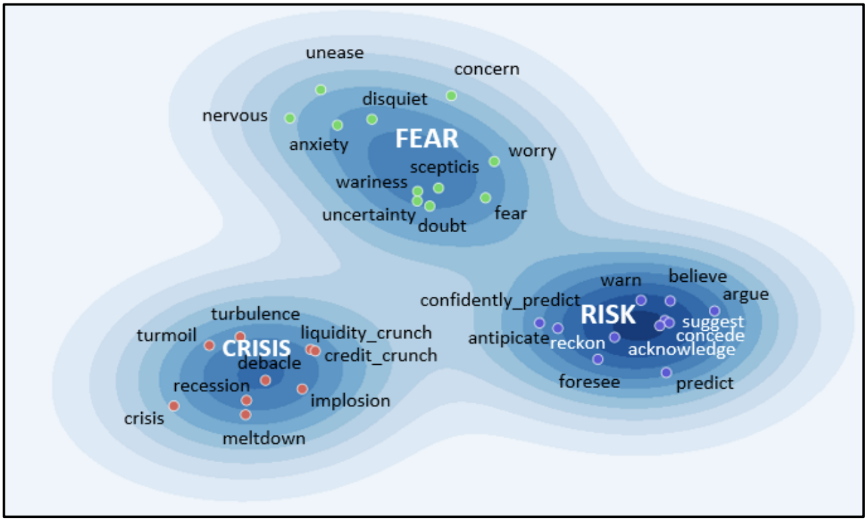
Literature Review – Sentiment index (2)
Word Vector Representations
Semantic Cluster

Slide 24
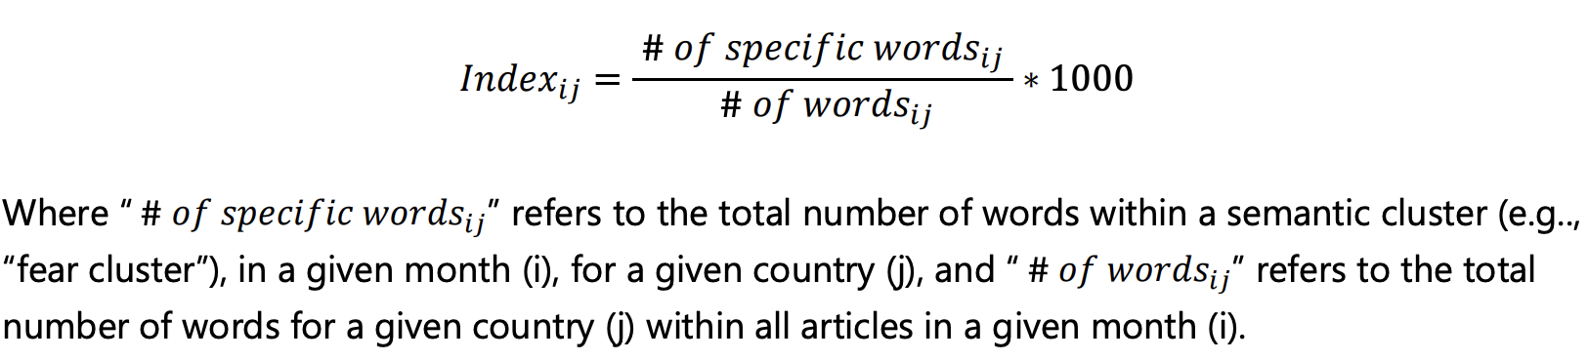
Literature Review – Sentiment index (3)
Constructing Sentiment Indices based on Semantic Clustering:
Build word vector representations using a large corpus of news articles (3,114,080 articles) from the FT between 1980 and 2019.
“Seed” words that characterize specific sentiment are: “fear”, “risk”, “hedging”, “opinion”, “crisis”.
Construct country-specific indices by identifying articles associated with a specific country.

Slide 25
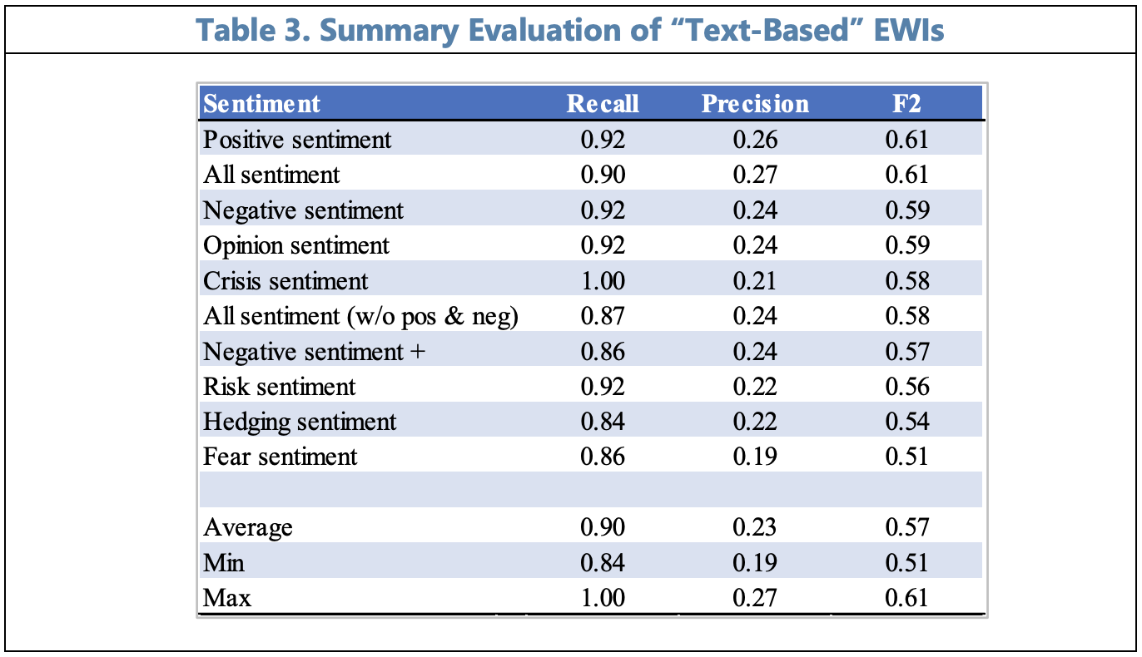
Literature Review – Sentiment index (4)
Prediction Performance
"Positive" and "All Sentiment" have the highest forecasting power
On average, all sentiments precede between 57 and 90 percent of the identified crisis
General indices display better forecasting performance

Slide 26
Suggested Methodology
Form a 3x levered long only Risk Parity Portfolio using a mixture of 4 securities futures, 2 treasury futures and 1 gold future
['SP1 Index', 'GX1 Index', 'Z1 Index', 'NK1 Index','US1 Comdty', 'FV1 Comdty', 'GC1 Comdty']
Rebalance the volatility contributions of the 7 assets 4 times every ~260 business days
A separate portfolio was also tested which contained only ['SP1 Index', 'GX1 Index', 'Z1 Index', 'NK1 Index'] and rebalanced 4 times every ~260 business days

Slide 27
Suggested Methodology
Use a linear combination of min-max normalized risk indicators to form a risk index ['VIX Index', 'BASPCAAA Index', 'BICLB10Y Index']
When risk index exceeds 0.5* max value within the time period, activate risk off and override the original positions of assets. Rebalance entire portfolio daily to equal risk contribution weights of only treasury and gold futures
For test portfolio of purely equities futures, when risk index exceeds optimal value * max value, set all positions to 0)
Test for 2 sample time periods separately and check cumulative returns of Portfolio with Risk indicator vs portfolio without risk indicator

Slide 28
PRELIMINARY Results (in sample, out sample)
First period contains 2 financial crises, 1997 Asian Financial Crisis and Early 2000s recession
Second period contains 2007 Financial Crisis and Covid

Slide 29
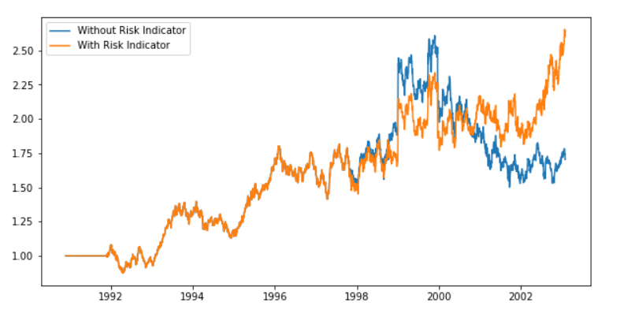
PRELIMINARY Results (in sample, out sample)
First period (1990-11-23 to 2003-01-30)
Cumulative return of 2.63 (With Risk Indicator) vs 1.70 (Without Risk Indicator)

Slide 30
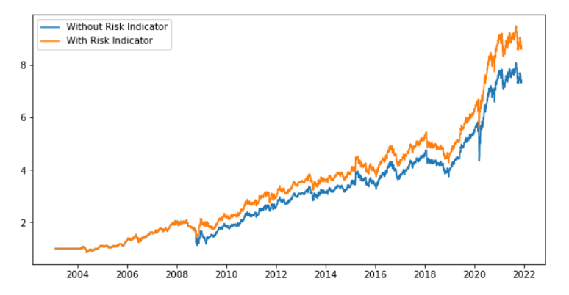
PRELIMINARY Results (in sample, out sample)
Second period (2003-01-31 to 2021-11-30)
Cumulative return of 8.61 (With Risk Indicator) vs 7.33 (Without Risk Indicator)

Slide 31
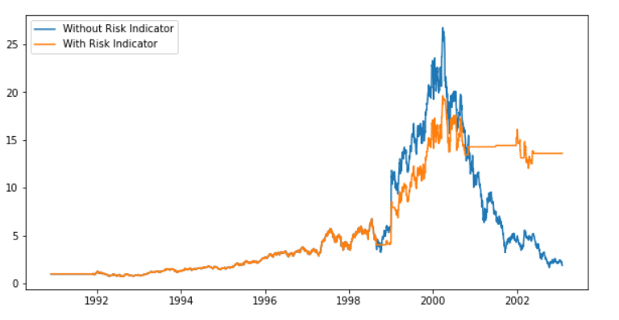
New portfolio test (using search)
First period (1990-11-23 to 2003-01-30)
Cumulative return of 13.58 (With Risk Indicator) vs 1.89 (Without Risk Indicator)

Slide 32
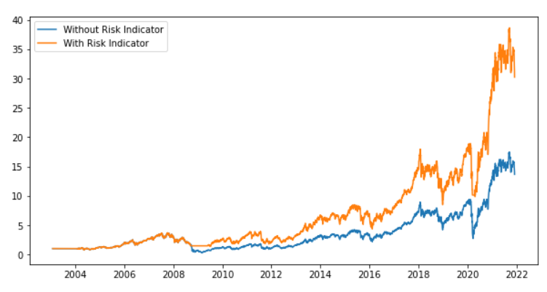
New portfolio test (using search)
Second period (2003-01-31 to 2021-11-30)
Cumulative return of 30.22 (With Risk Indicator) vs 13.65 (Without Risk Indicator)

Slide 33
References
Lee. (2012). Risk on/risk off. Journal of Portfolio Management, 38(3), 28–39. https://doi.org/10.3905/jpm.2012.38.3.028
News-based Sentiment Indicators. (2019) Huang, Chengyu ; Simpson, Sean ; Ulybine, Daria ; Roitman, Agustin. In: IMF Working Papers. RePEc:imf:imfwpa:19/273
Baek S, Lee KY, Uctum M, Oh SH. Robo-Advisors: Machine Learning in Trend-Following ETF Investments. Sustainability. 2020; 12(16):6399. https://doi.org/10.3390/su12166399
Qian, E. (2011). Risk parity and diversification. The Journal of Investing, 20(1), 119-127.4
Fabozzi, F. A., Simonian, J., & Fabozzi, F. J. (2021). Risk Parity: The Democratization of Risk in Asset Allocation. The Journal of Portfolio Management, 47(5), 41-50.
Hakkio, C. S., & Keeton, W. R. (2009). Financial stress: What is it, how can it be measured, and why does it matter. Economic Review, 94(2), 5-50.
Cardarelli, R., Elekdag, S., & Lall, S. (2011). Financial stress and economic contractions. Journal of Financial Stability, 7(2), 78-97.

Slide 34
thank you
Do you have any questions?

